Slide 1


MODFLOW 6 Groundwater Flow Model
47TH IAH Congress
São Paulo, Brazil
August 22, 2021
Notes:
Describe some of the ongoing work we are doing with MODFLOW
MODFLOW and related software distributed by the USGS is developed and supported by a growing team of USGS scientists and external collaborators. Recent MODFLOW development efforts have focused on use of unstructured and locally refined grids for constant or variable-density groundwater flow and solute transport simulation, robust handling of three-dimensional anisotropy, generalization and tracking of water transfer between packages, distributed memory parallelization, and consolidation of these core capabilities into MODFLOW 6. These capabilities make it possible to construct new types of models, such as tightly coupled nested models, that have not been possible with previous MODFLOW versions. Underlying these efforts has been the adoption of an open-development philosophy that relies on testing-based development and continuous integration practices by the core development team and by the broader MODFLOW community. Ongoing development increasingly relies on the Flopy python package for automating model construction. Resulting from these development efforts is a suite of MODFLOW programs that can be applied at local, regional, and National scales for a wide variety of complex groundwater flow and transport problems.
OASIS MCT

Slide 2
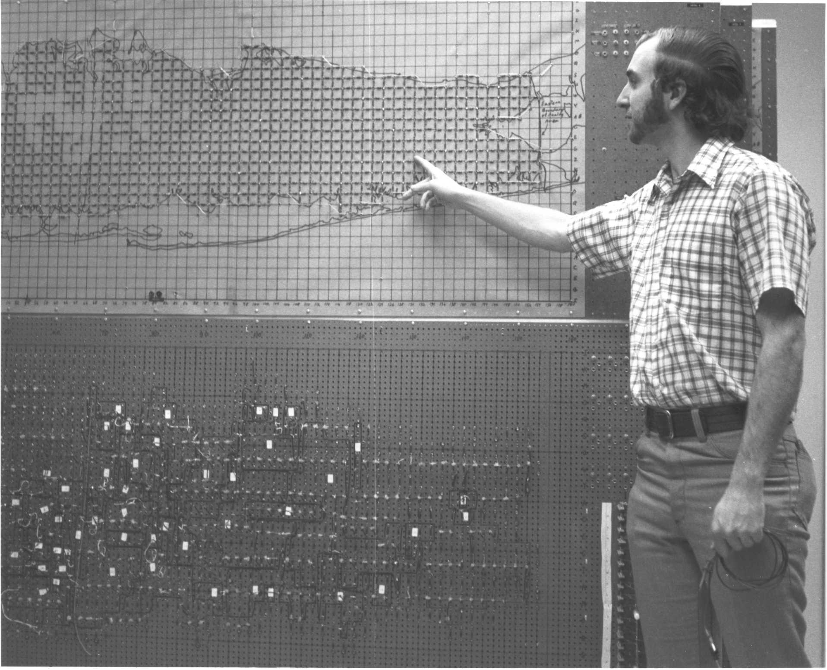
GROUNDWATER MODELING background AT THE USGS

Slide 3
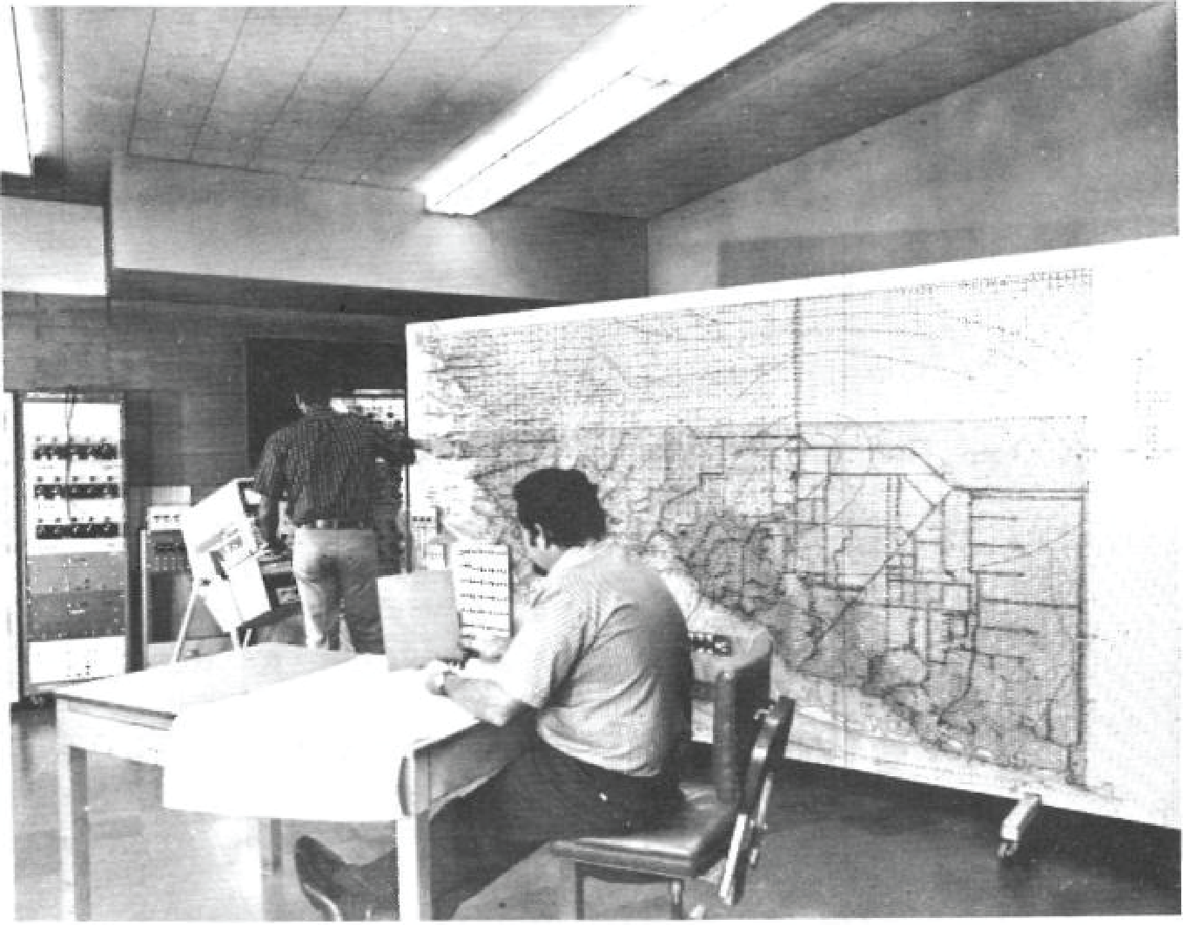

Slide 4
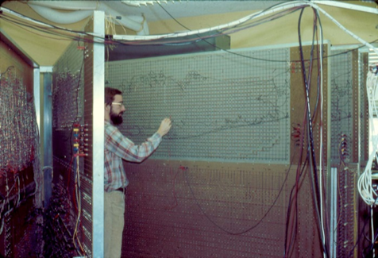

Slide 5
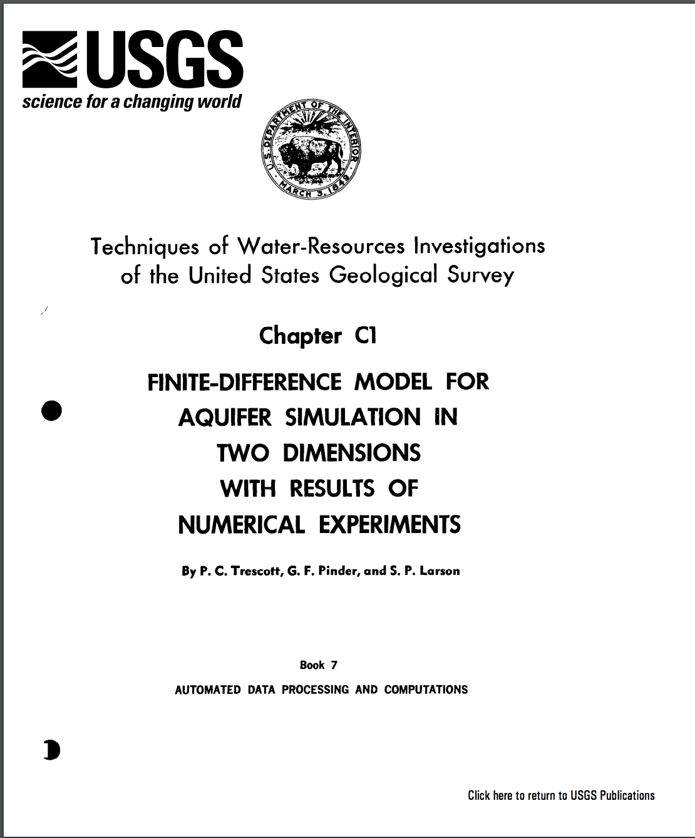
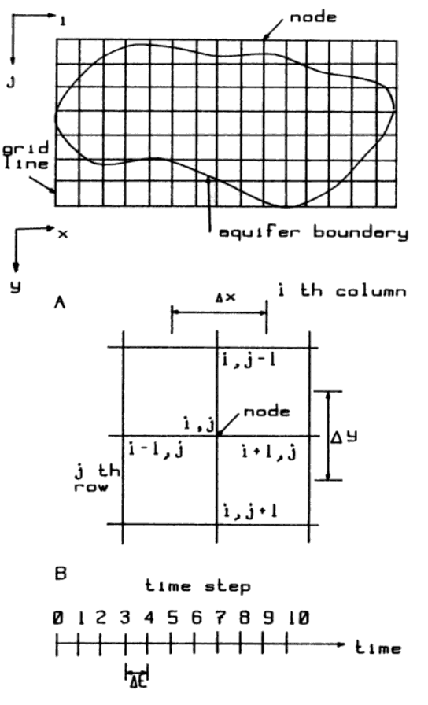

Slide 6
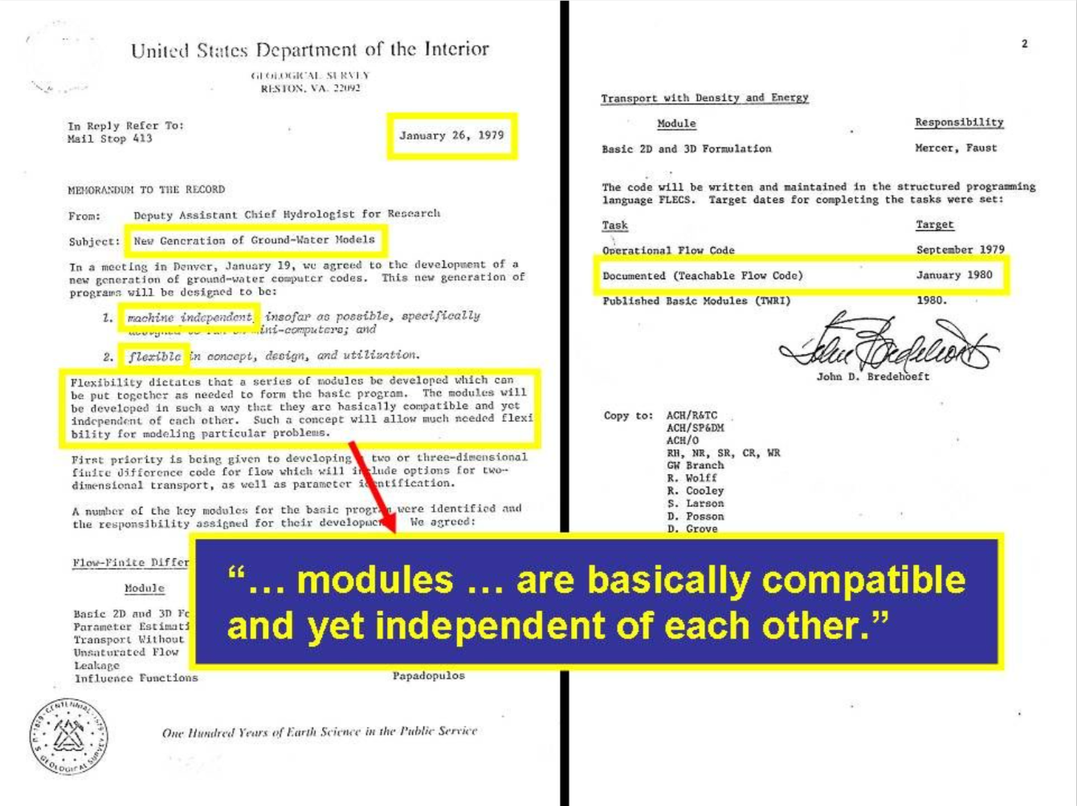
Notes:
I sometimes show this slide that I received from Lenny Konikow to give some historical context about MODFLOW. This is an internal USGS memo from John Bredehoeft in 1979 that gives the marching orders to begin developing MODFLOW. There are a few important things to note here: (1) this was 40 years ago! (2) the model should be machine independent, flexible, and teachable, Modules are independent of one another!

Slide 7
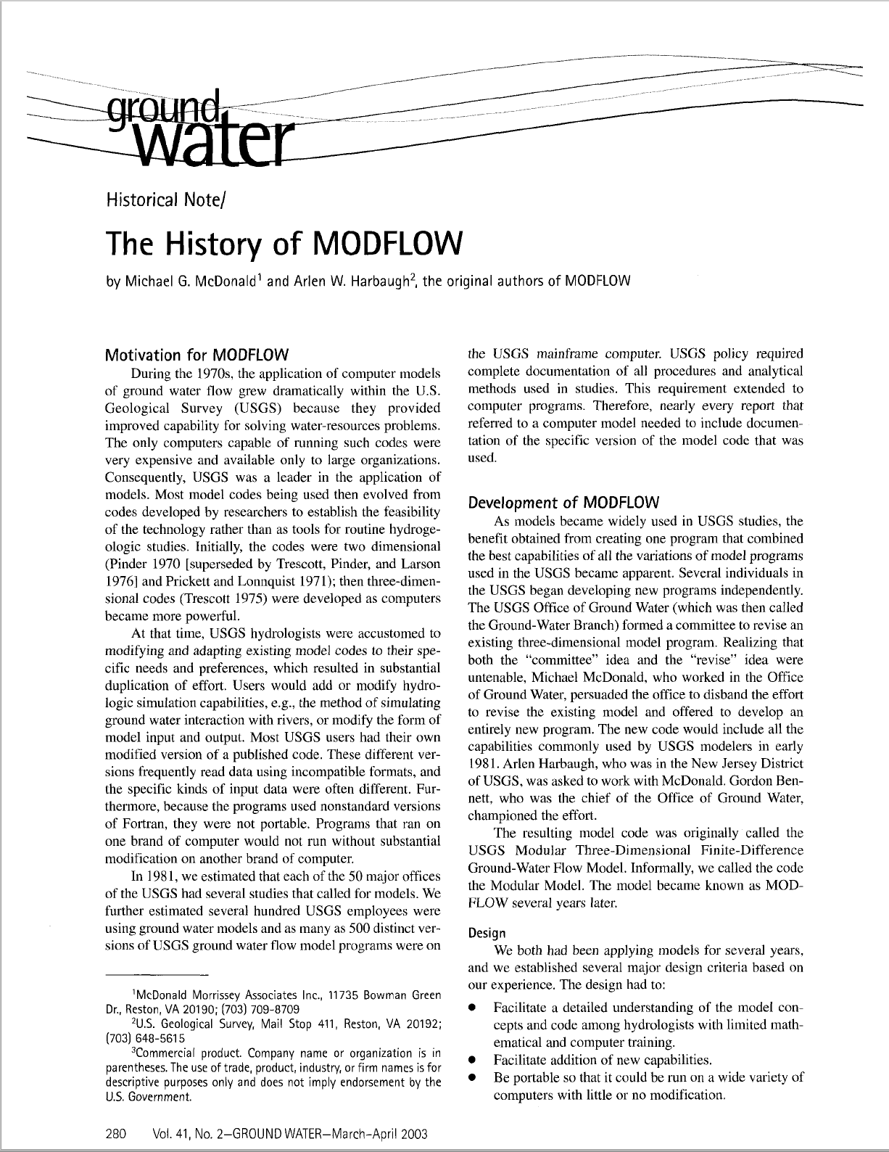

Slide 8
MODFLOW Philosophy
Core Principles
Teachable
Documented
Reliable
Robust
Efficient
Extensible
Portable
Notes:
I was lucky to have the opportunity to work with Arlen Harbaugh for a couple of years. Arlen is one of the original developers of MODFLOW. Arlen saw MODFLOW as more than just a program. MODFLOW was the philosophy before a number of core principals: …. Many believe these core principals are behind MODFLOW’s popularity. We are here 40 years later at the MODFLOW conference.

Slide 9
MODFLOW Support Environment
Groundwater Vistas GMS Visual MODFLOW. PMWIN ModelMuse Groundwater Desktop Leapfrog Hydro FREEWAT iMOD ModelViewer FloPy Graphical Interfaces and Scripting
Core Principles
Teachable
Documented
Reliable
Robust
Efficient
Extensible
Portable
Notes:
Because of it’s popularity, a wide variety of tools have been developed to support MODFLOW…

Slide 10
Solute and Heat
Transport
Landscape
Hydrology
Reactive
Transport
Parallel
Flow Path
Analysis
Groundwater Vistas GMS Visual MODFLOW. PMWIN ModelMuse Groundwater Desktop Leapfrog Hydro FREEWAT iMOD ModelViewer FloPy Graphical Interfaces and Scripting
Core Principles
Teachable
Documented
Reliable
Robust
Efficient
Extensible
Portable
Subsidence
Karst and
Pipe Flow
Unstructured
Grids
Management
Parameter
Estimation
and Uncertainty
Unsaturated
Zone
Surface Water
Flow
Notes:
Over the years, our groundwater problems have become more and more complex. As hydrogeologists and scientists , we are being asked to address karst problems, transport problems, unsaturated zone problems, etc. As a result, MODFLOW has been expanded to incorporate other processes and coupled with a variety of other models.

Slide 11
MT3DMS
MT3D-USGS
SEAWAT, SWI
GWT
GSFLOW-PRMS
SWB, HSPF, SWAT
OWHM
PHREEQC-PHT3D
PHWAT
RT3D
Solute and Heat
Transport
Landscape
Hydrology
Reactive
Transport
MODPATH
mod-PATH3DU
PATH3D
FlowSource
SAMG
PKS-MODFLOW
PKS-SEAWAT
MODFLOW 6
Parallel
Flow Path
Analysis
Groundwater Vistas GMS Visual MODFLOW. PMWIN ModelMuse Groundwater Desktop Leapfrog Hydro FREEWAT iMOD ModelViewer FloPy Graphical Interfaces and Scripting
Core Principles
Teachable
Documented
Reliable
Robust
Efficient
Extensible
Portable
Subsidence
Karst and
Pipe Flow
SUB
CSUB
MODFLOW-USG
CFP, VKD
Unstructured
Grids
Management
PESTPP-OPT
MODSIM
GWM
Parameter
Estimation
and Uncertainty
Unsaturated
Zone
MODFLOW-USG
MODFLOW 6
Surface Water
Flow
PEST
PESTPP
UCODE
UZF
HYDRUS
VSF
SFR, SWR
HEC-RAS
BRANCH
MODFLOW
ECOSYSTEM OF CODES
Notes:
This slide, which is surely incomplete, shows a MODFLOW ecosystem in which many different packages, processes, and codes have been written or coupled to solve these problems. This is an impressive collection of capabilities that use MODFLOW in one way or another.

Slide 12
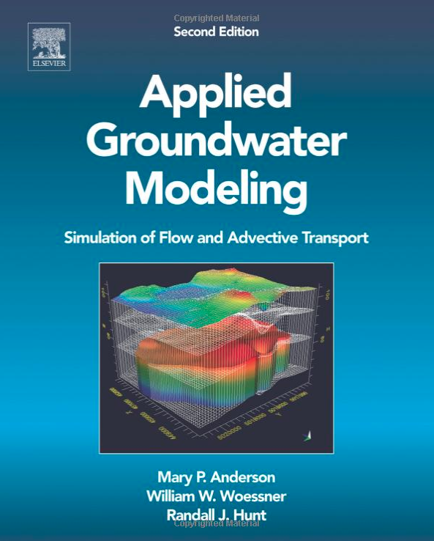
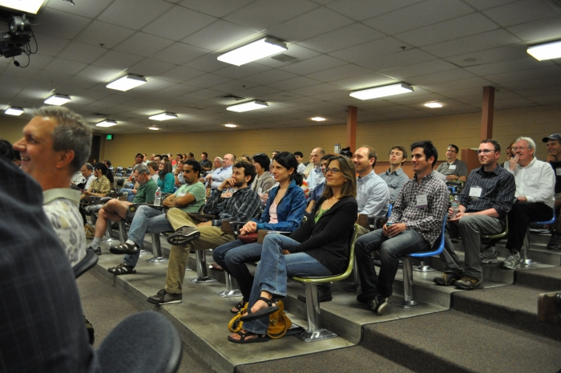
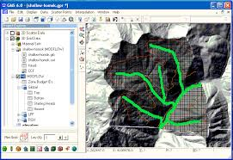
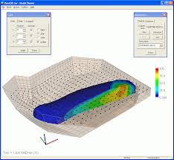
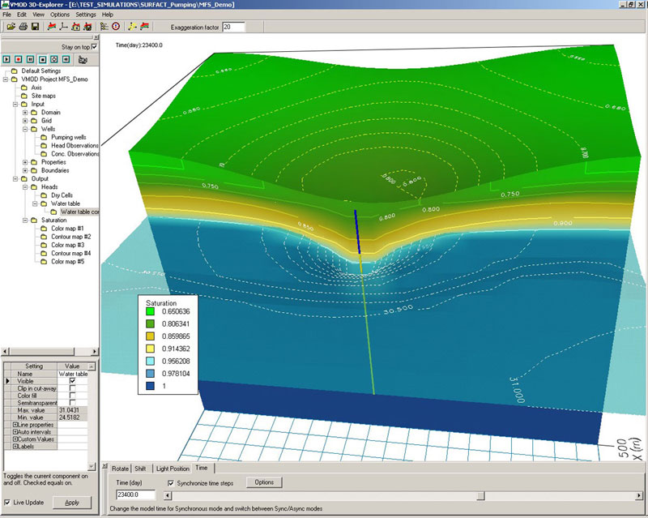
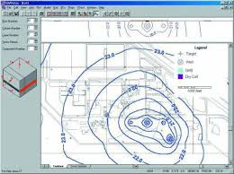
MODFLOW User Base
Academics
Private Consultants
Local, State, and Federal Government
MODFLOW and More Conference
Notes:
Most groundwater availability studies used MODFLOW

Slide 13
Evolving Simulation Needs
GW issues becoming more complex
Proliferation of new versions and packages
Increase in package complexity
Loss of package independence
Incompatibilities
Difficult to add other process models to MODFLOW; same grid required for all packages and processes
Notes:
----- Meeting Notes (8/13/15 09:29) -----
GW-SW interaction
Watershed hydrology
Geomechanical issues with subsidence
Chemistry
Management

Slide 14
MODFLOW Next Generation
2013 Office of Groundwater initiated a major MODFLOW revision
Rewrote MODFLOW using an object-oriented design
Consolidated capabilities from previous MODFLOW versions
Changed name from “Modular Groundwater Model” to “Modular Hydrologic Model”
Published MODFLOW 6 in 2017
Try to follow modern software design principles

Slide 15



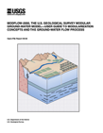
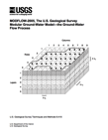
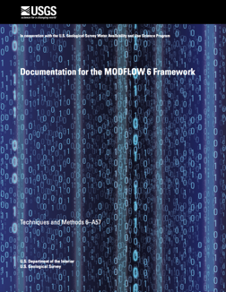
MODFLOW 6
Consolidate popular capabilities from previous MODFLOW versions (2005, NWT, USG, LGR, …)
Improve solution technique
Modernize code and input structure
Support multi-model simulations
Extend MODFLOW into a hydrologic simulator
New core version (Released August 2017)
1984
1988
1996
2000
2005
2017
Notes:
MODFLOW 6 will combine the best features of existing versions of MODFLOW and get rid of outdated functionality. Highly coupled and complex systems will be solved with one system of equations making this MODFLOW version much faster than with previous versions of MODFLOW that iteratively solved the flow part, then the other parts, like transport or local grid refinement. This effort intends to modernize MODFLOW’s design to account for 20+ years of improvements in software design and essentially making MODFLOW a more of a hydrologic simulator.

Slide 16

MODFLOW 6
Notes:
Our group is charged with developing and maintaining the USGS MODFLOW program. This is includes MODFLOW-2005, MODFLOW-NWT, MODFLOW-USG, SEAWAT, and others. In 2017 we released MODFLOW 6 as a new version of MODFLOW that we could use to build from.

Slide 17
MODFLOW 6 Framework

Slide 18
MODFLOW 6 Framework Concepts
Simulation
Solution
Model
Packages
Exchanges
Notes:
Groundwater Flow
Transport
Pipe Network
Surface Water Flow
Landscape Hydrology

Slide 19
MODFLOW Framework Components
MODFLOW-2005
MODFLOW 6

Slide 20
Nested Grids
Parent
Child 1
Child 2
Grandchild

Slide 21
Multi-Level Grid Nesting
Notes:
Large scale and fine scale

Slide 22
MODFLOW 6 Framework
Advantages
Disadvantages
Models are independent
Models can have their own resolution
Models can be developed separately
Models can run independently
Models can be tightly coupled at the matrix level
Input and output is standardized
Model / package approach is highly modular and extensible
Platform independent, can run on a supercomputer or a Raspberry Pi
Models must be programmed to work in the framework
Framework primarily tested for groundwater
Framework has been applied to models with an implicit formulation
Framework requires dedicated maintenance and support

Slide 23
MODFLOW 6 Framework Simulation Components
Simulation
Timing Module
Solutions
Models
Exchanges
Utilities
Timing Module
Solution 1
Model 1
Model 2
Model 3
Model 4
Exchange 1
Exchange 2
Exchange 3

Slide 24
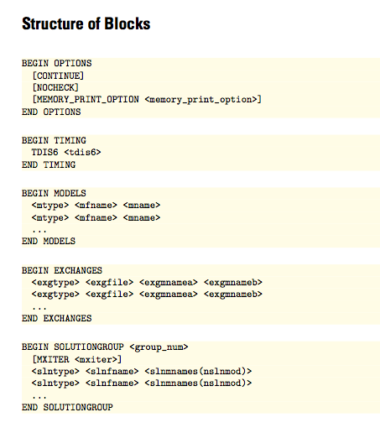
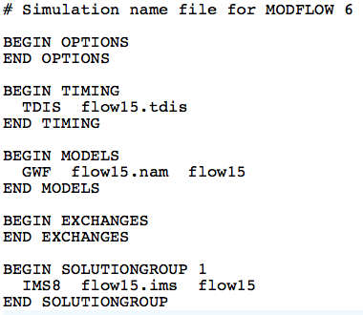
MODFLOW 6 Framework Simulation Name File
Required even for common case with one model
Named mfsim.nam
One simulation per folder

Slide 25
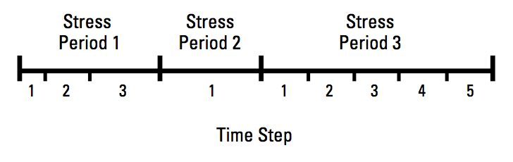
MODFLOW 6 Framework Timing Module
TDIS Package
Uses the MODFLOW concepts of stress periods, time steps
Alternative timing packages may be developed in the future
Timing applies to all models

Slide 26
MODFLOW 6 Framework Stress Period Data
BEGIN OPTIONS
PRINT_INPUT
PRINT_FLOWS
SAVE_FLOWS
END OPTIONS
BEGIN DIMENSIONS
MAXBOUND 42
END DIMENSIONS
BEGIN PERIOD 1
# canal
1 1 1 330.0
1 2 1 330.0
1 3 1 330.0
1 4 1 330.0
...
# river
1 1 20 320.0
1 2 20 320.0
1 3 20 320.0
...
END PERIOD
Stress are active until changed by the user
Different from previous MODFLOW versions
Can be specified using time series

Slide 27
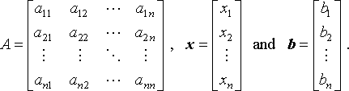
MODFLOW 6 Framework Solutions
Used to solve one or more models and exchanges
The only solution available now is the Iterative Model Solution, or IMS
Unstructured and asymmetric
IMS solves the following nonlinear equation
Ax = b

Slide 28
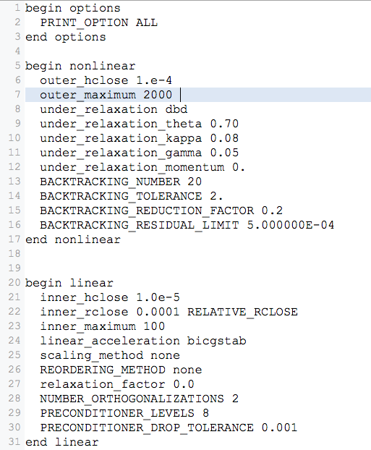
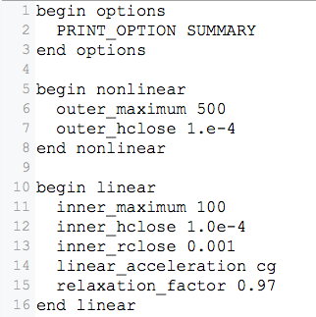
Iterative Model Solution (IMS6)

Slide 29
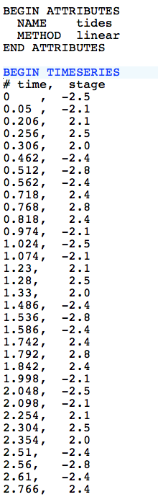
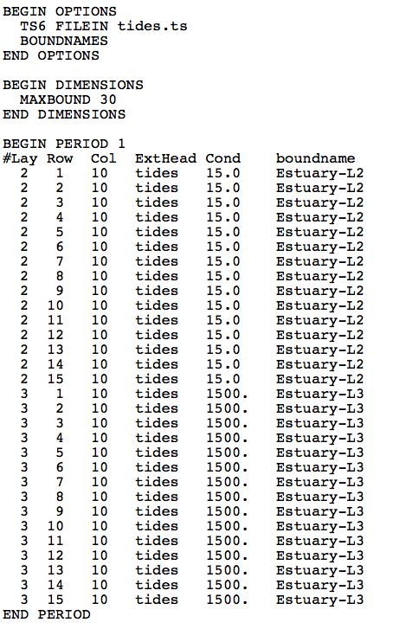
MODFLOW 6 Framework Time Series
tides.ts
GHB Input File

Slide 30
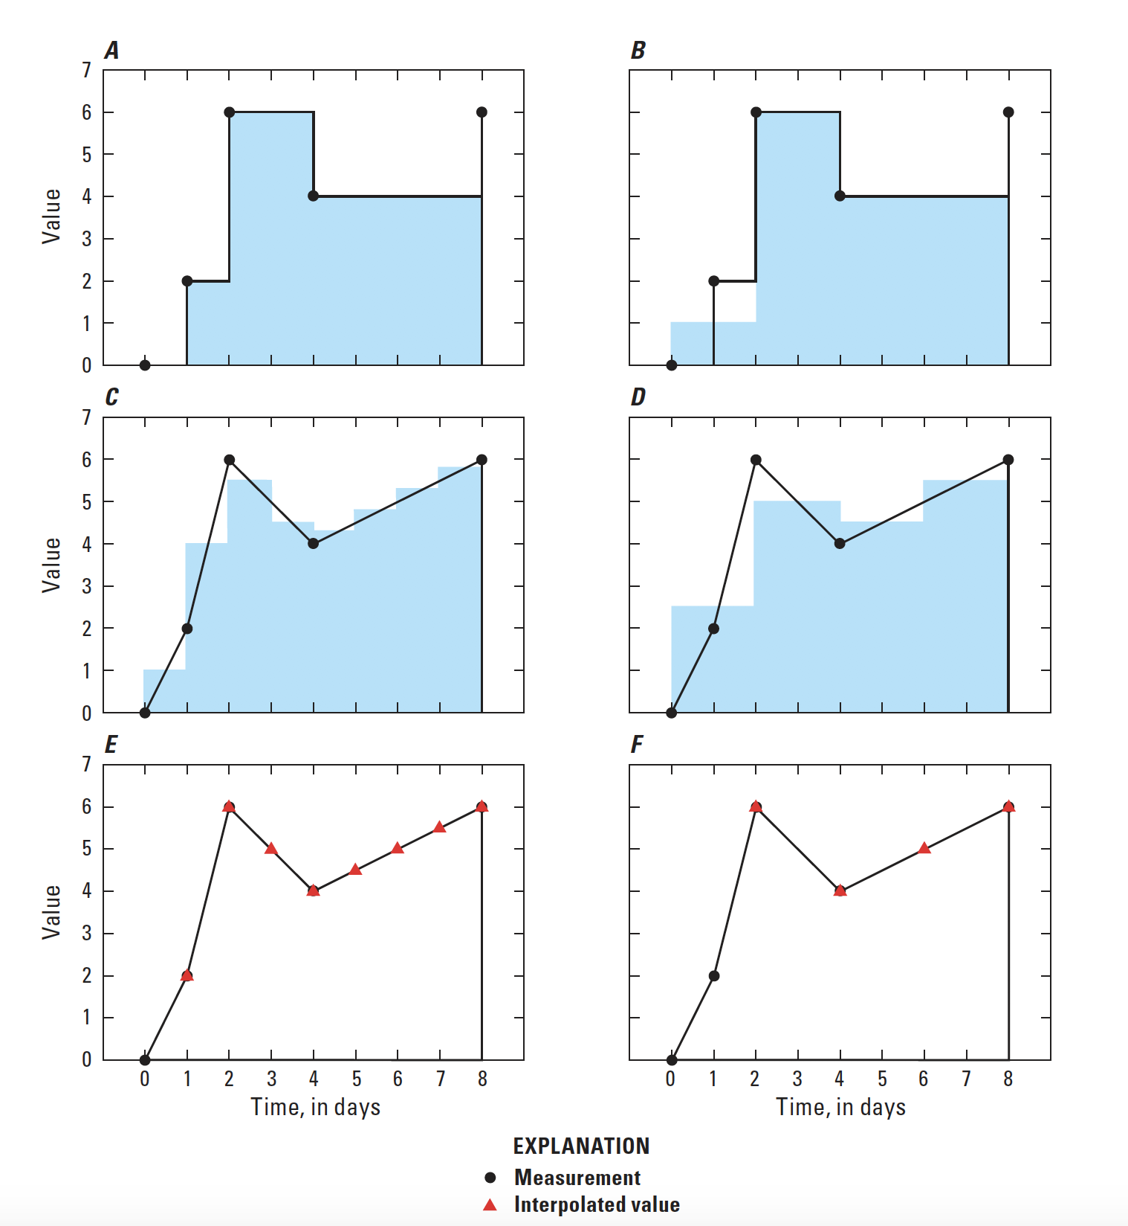
Timeseries Interpolation Methods
STEPWISE
Values are constant until changed
LINEAR
Average value is calculated for the time step
LINEAREND
Value interpolated at end of time step

Slide 31
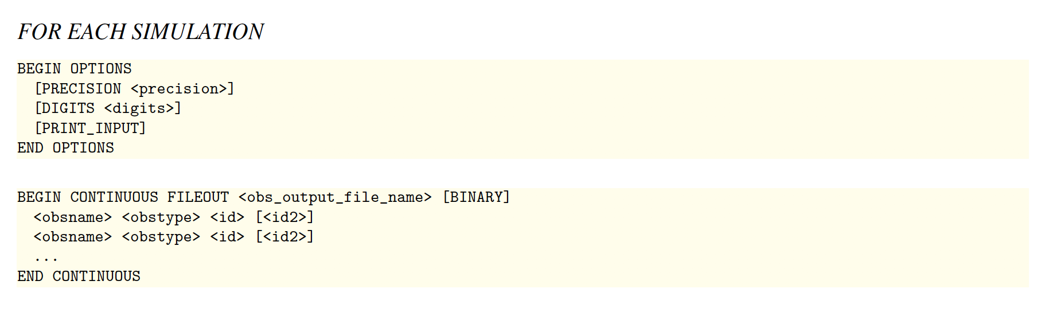
MODFLOW 6 Framework Observations
OBS Package for GWF Model
Heads
Flow between cells
Separate OBS files for each package

Slide 32
Groundwater flow (GWF) model

Slide 33
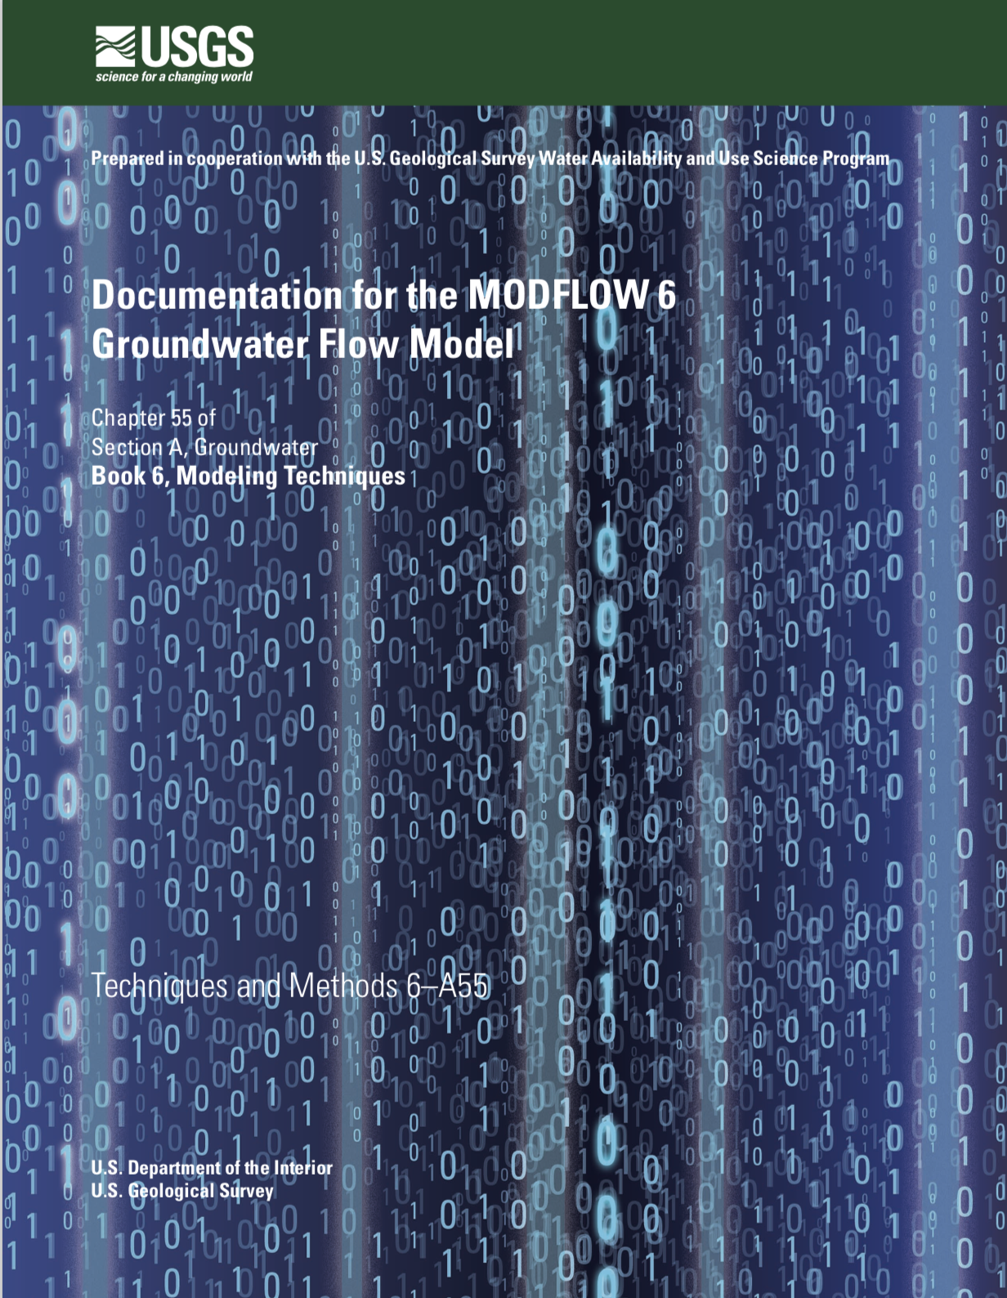
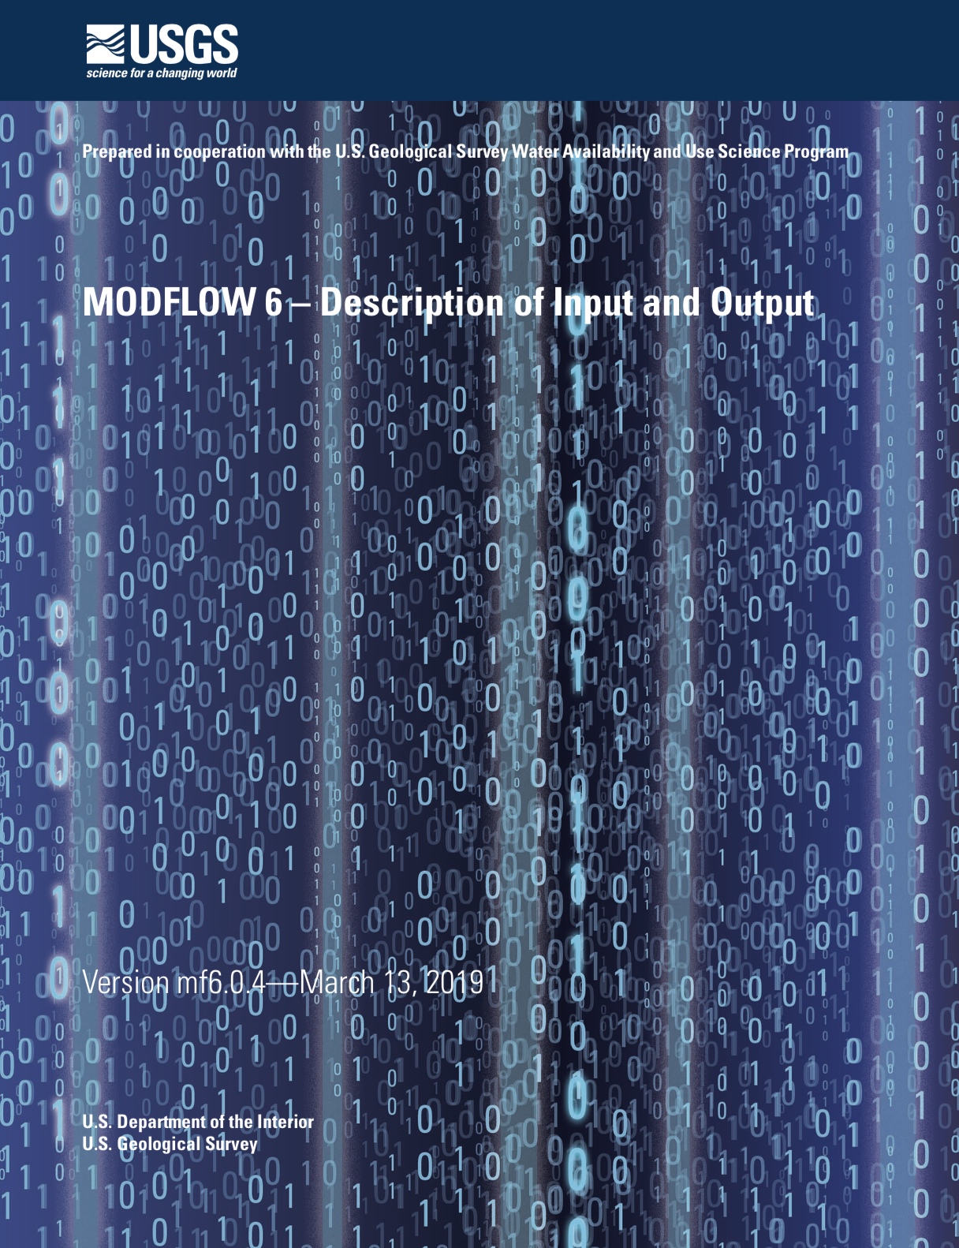
GWF Documentation

Slide 34
GWF Model Highlights
Generalized control-volume finite-difference formulation
Regular MODFLOW grids
Unstructured grids
IDOMAIN capability
Full 3D anisotropy
Multiple stress package ”instances”
Block and keyword input structure

Slide 35
UNDERLYING Formulation

Slide 36
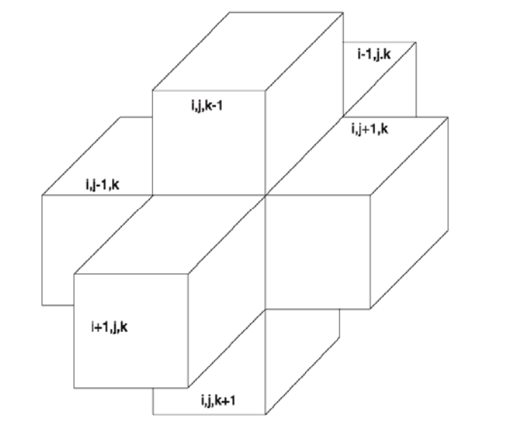
Finite-Difference Equation

Slide 37
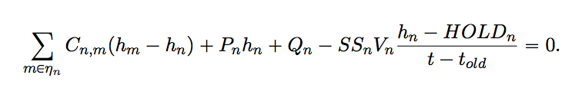
Generalized CVFD Equation

Slide 38
DISCRETIZATION

Slide 39
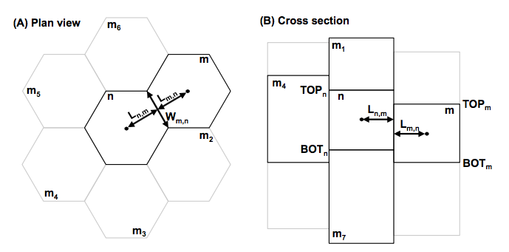
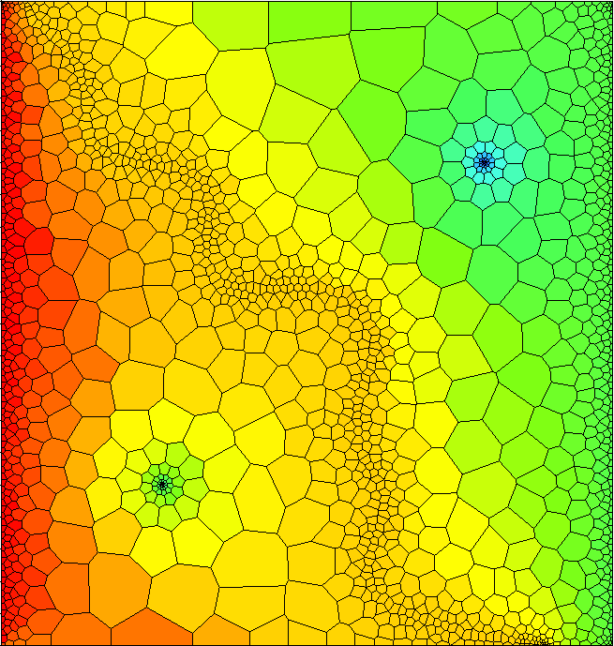
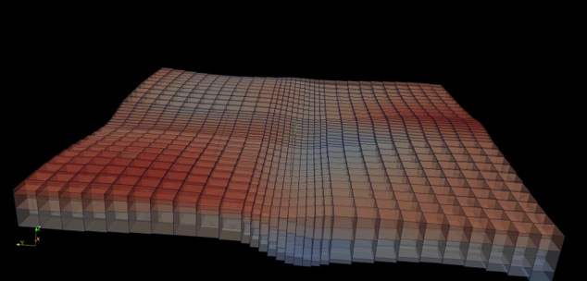
Spatial Discretization
Three ways to enter grid
DIS – regular MODFLOW grid
DISV – discretization by vertices
DISU – fully unstructured

Slide 40
Discretization (DIS) Package
“Regular MODFLOW grid”
Consists of layers, rows, and columns
Top and bottoms can have variable elevations

Slide 41
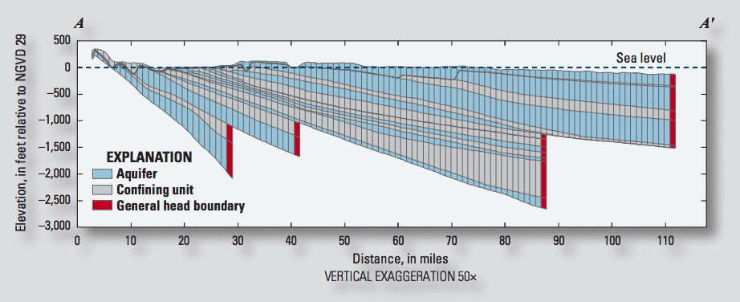
IDOMAIN Capability
Improve efficiency for models with large areas of inactive cells
Address MODFLOW limitations with discontinuous hydrogeologic layers

Slide 42
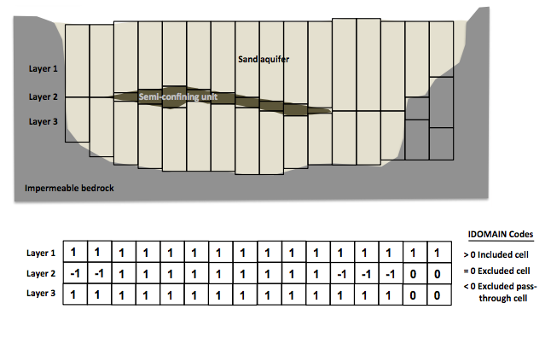
IDOMAIN Capability (cont.)
Permanently remove a cell from the simulation
Can be used with DIS and DISV
Optionally connect overlying and underlying cells

Slide 43
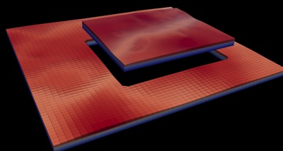
Multi-Model Simulation
MODFLOW 6 foundation allows models to be tightly coupled at the matrix level
Allows local grid refinement (LGR), and other model coupling strategies

Slide 44
LGR Simulation
Simulation
Temporal Discretization
PARENT
C1
C2
GC
Iterative Model Solution

Slide 45
GWF Exchanges
Simulation
Temporal Discretization
PARENT
C1
C2
GC
Iterative Model Solution
PARENT-C1
PARENT-C2
C1-GC

Slide 46
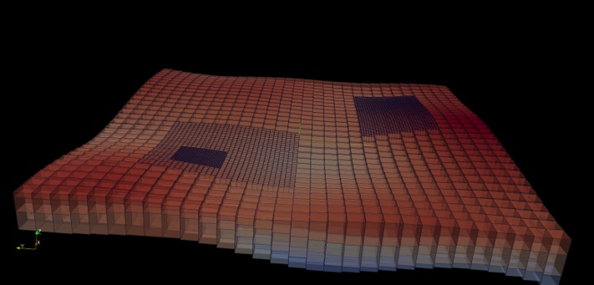
LGR Simulation
Simulation
Temporal Discretization
Simulation Name File
PARENT
BEGIN OPTIONS
END OPTIONS
BEGIN TIMING
TDIS6 mysim.tdis
END TIMING
BEGIN MODELS
GWF6 parent.nam PARENT
GWF6 c1.nam C1
GWF6 c2.nam C2
GWF6 gc.nam GC
END MODELS
BEGIN EXCHANGES
GWF6-GWF6 parent-c1.exg PARENT C1
GWF6-GWF6 parent-c2.exg PARENT C2
GWF6-GWF6 c1-gc.exg C1 GC
END EXCHANGES
BEGIN SOLUTIONGROUP 1
IMS6 mysolver.ims PARENT C1 C2 GC
END SOLUTIONGROUP
C1
C2
GC
Iterative Model Solution
PARENT-C1
PARENT-C2
C1-GC

Slide 47
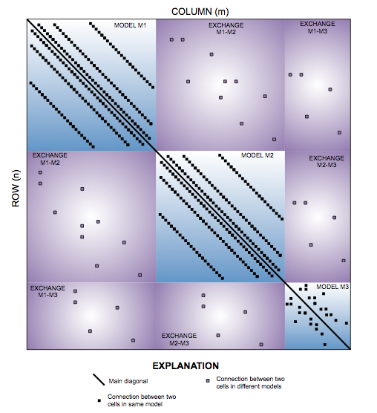
Matrix-Level Coupling
Simulation
Temporal Discretization
PARENT
C1
C2
GC
Iterative Model Solution
PARENT-C1
PARENT-C2
C1-GC
Notes:
Because our solver is unstructured and asymmetric, can handle Newton-Raphson, unstructured grids, ghost nodes, XT3D, dispersion tensors, etc…

Slide 48
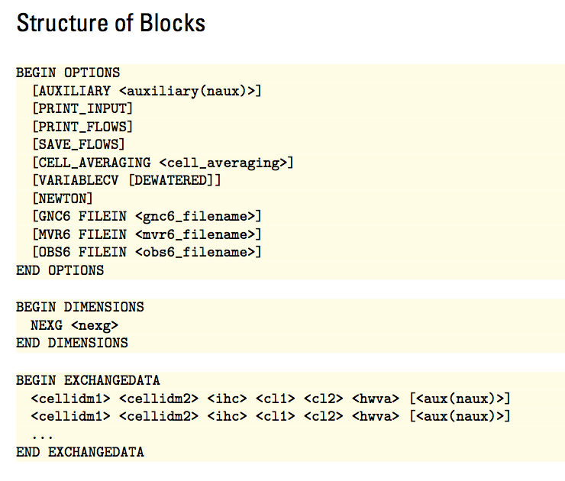
GWF6-GWF6 Exchange

Slide 49
NODE PROPERTY FLOW PACKAGE

Slide 50
Node Property Flow (NPF) Package
Primary purpose is to calculate conductance between adjacent cells
Confined or convertible cells (ICONVERT)
Homogeneous or heterogenous
Isotropic or anisotropic
Handles wetting and drying (REWET, WETDRY) (still available, but the Newton-Raphson method is much better)
Can calculate the three components of specific discharge at the cell center (SAVE_SPECIFIC_DISCHARGE). Nice for vector plots, and required for transport.

Slide 51
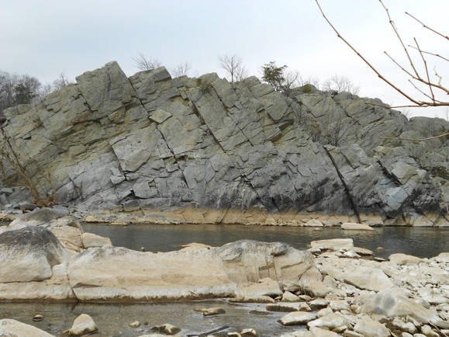
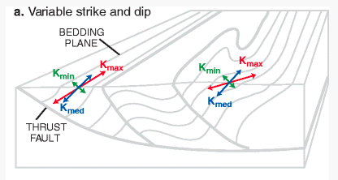
Representation of Anisotropy
Representation of full 3D anisotropy may be required for some problems (fractured aquifers, structurally deformed aquifers)
Some capabilities available (LVDA, SUTRA), but needed generalized CVFD method

Slide 52
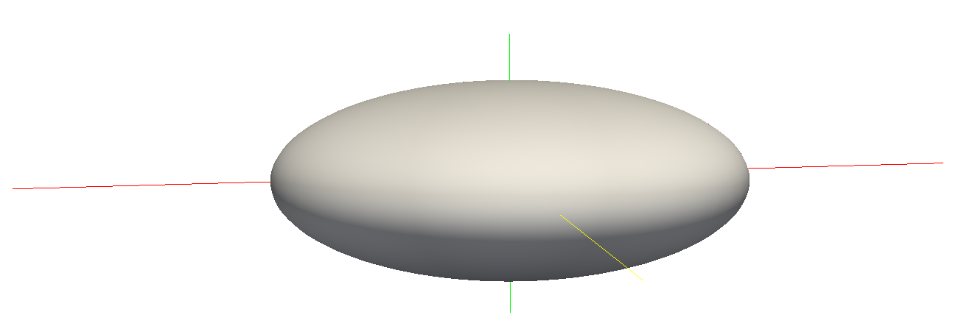
Hydraulic Conductivity Ellipsoid
Defined by three user-provided values on a cell by cell basis
For unrotated case,
K11 = Kx
K22 = Ky
K33 = Kz
K11
K22
K33

Slide 53
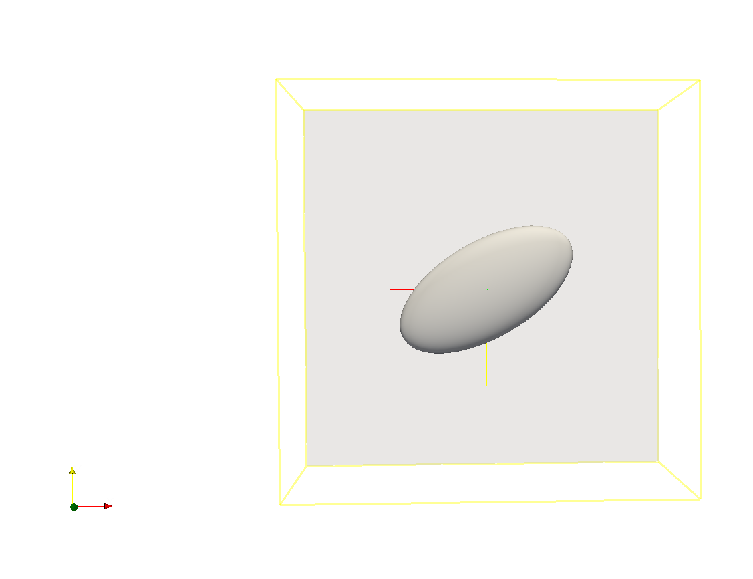
Ellipsoid Rotation
Users can optionally provide ANGLE1, ANGLE2, and ANGLE3 on a cell by cell basis
ANGLE1 is counter-clockwise rotation in the x, y plane

Slide 54
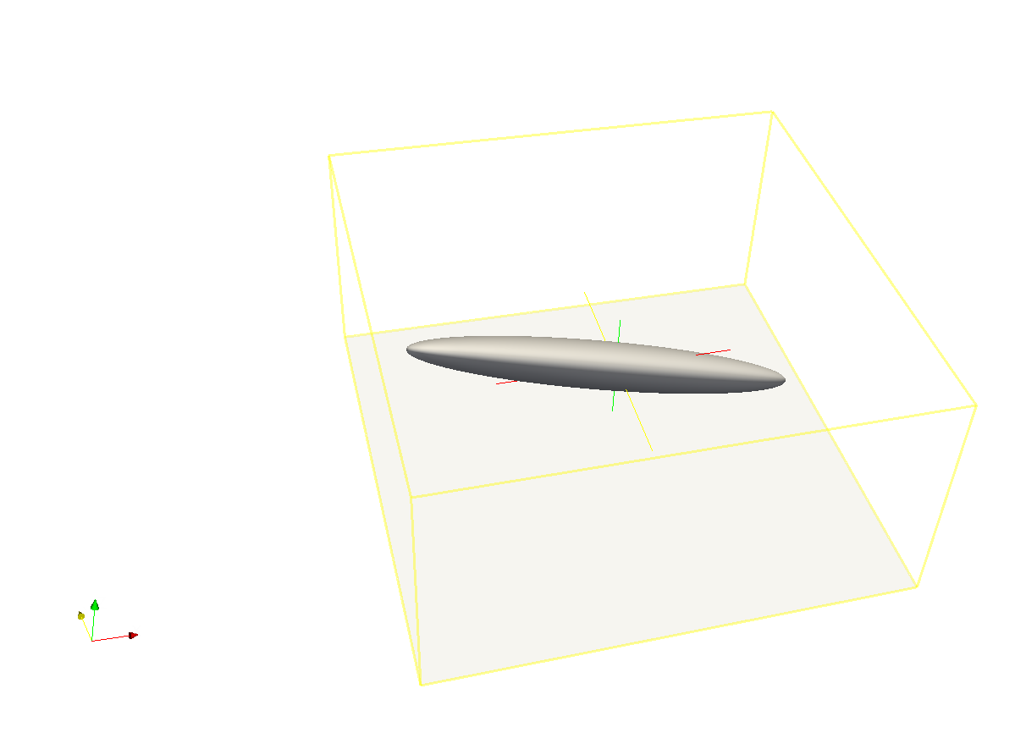
Ellipsoid Rotation (cont.)
All three angles can be specified to represent ellipsoid orientation

Slide 55
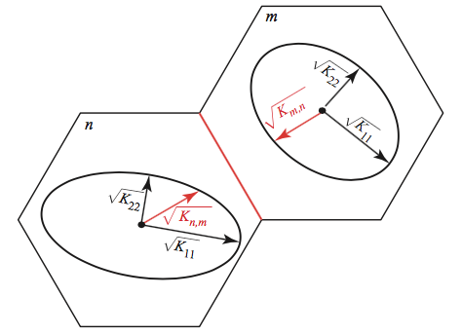
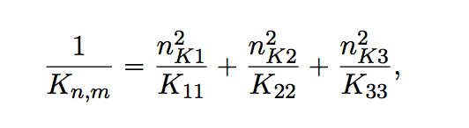
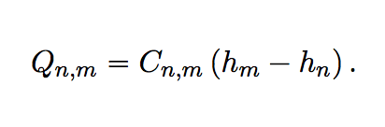
Effective Conductivity Approach
Large errors for certain ellipsoid configurations
Approximate, but relatively fast
Simple to implement

Slide 56
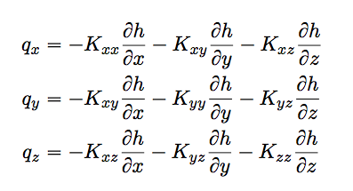
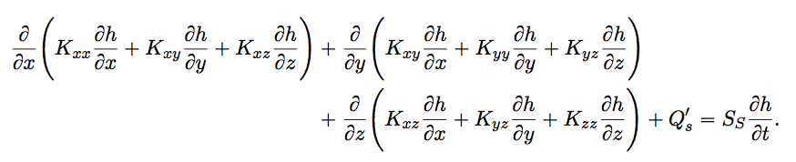
XT3D Approach
General and robust handling of anisotropy
Computationally expensive
Improves flow solution for certain grid types
More on this later

Slide 57
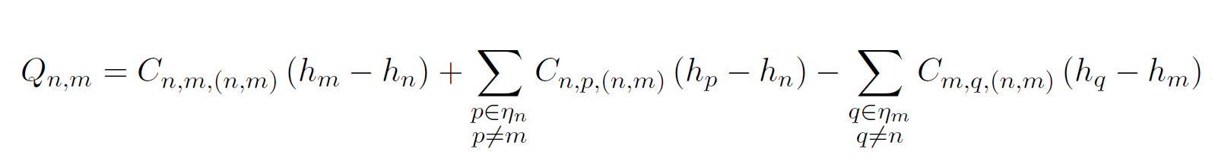
XT3D flow expression
Flow between two cells expressed in terms of conductance-like coefficients that can involve all neighbors of the two cells

Slide 58

XT3D flow expression
Flow between two cells expressed in terms of conductance-like coefficients that can involve all neighbors of the two cells

Slide 59

XT3D flow expression
Flow between two cells expressed in terms of conductance-like coefficients that can involve all neighbors of the two cells

Slide 60

XT3D flow expression
Flow between two cells expressed in terms of conductance-like coefficients that can involve all neighbors of the two cells

Slide 61
XT3D flow expression
Flow between two cells expressed in terms of conductance-like coefficients that can involve all neighbors of the two cells
Larger stencil than in standard conductance-based MODFLOW formulation

Slide 62
XT3D performance
Longer run times than standard MODFLOW formulation
Requires more memory than standard MODFLOW formulation
“RHS” suboption makes memory requirement comparable to default formulation (same stencil)

Slide 63
Newton-Raphson Formulation

Slide 64
Formulation Issues
Originally developed for groundwater flow problems with standard boundary conditions to solve linear (confined) to well-behaved non-linear (unconfined) problems.
Empirical wetting and drying approach added by McDonald and others (1992) to allow cell conversion to simulate more difficult unconfined problems.
Three-dimensional unconfined applications and head-dependent stress packages can create additional nonlinearities.

Slide 65
Wetting/Drying Nonlinearities
Standard Formulation approach:
Dry cells are inactivated. This creates discontinuities and oscillations. Furthermore, wetting/drying results in varying stresses (for example, wells disappear from dry cells).
Newton-Raphson Formulation approach:
Keep all cells active even when the head in a cell is below the bottom of the cell

Slide 66

Newton-Raphson method
Standard Formulation:
Newton-Raphson:
Jacobian:
http://tutorial.math.lamar.edu/Classes/CalcI/NewtonsMethod.aspx
Modified Newton-Raphson:

Slide 67
Newton-Raphson Formulation
Conductance transitions from head-dependent to constant
0
Cell
bottom
Cell
top
Transition causes to change from 1 to zero, a discontinuous derivative

Slide 68
Newton-Raphson Formulation
Smooth saturated thickness function over the discontinuity.

Slide 69
Standard Formulation
dry
wet
h_{n} = 90
S_{Fn} = 0
BOT_{n} = 90
h_{m} = 95
S_{Fm} = 5
BOT_{m} = 90
Standard Formulation intercell conductance based on saturated thickness will prevent flow from a wet cell to a dry cell.

Slide 70
Newton-Raphson Formulation
dry
wet
h_{n} = 90
S_{Fn} = 0
BOT_{n} = 90
h_{m} = 95
S_{Fm} = 5
BOT_{m} = 90
Conductance is calculated based on saturated thickness of cell with higher head. Thus, there will be flow from the wet cell to the dry cell.

Slide 71
Newton-Raphson Formulation
Since cells remain active, simulated heads can be less than the cell bottom.

Slide 72

Newton-Raphson Formulation
Under-relaxation for Newton Solutions

Slide 73
Newton-Raphson Formulation
Once Newton-Raphson is enabled in the GWF name file Newton-Raphson is also used for GWF terms formulated by
Storage Package
Well Package (auto flow reduce)
Lake Package*
Multi-aquifer Well Package
Streamflow Routing Package*
Unsaturated Zone Flow Package*
* Stress package continuity equation also solved using Newton-Raphson

Slide 74
Newton-Raphson Formulation
Newton-Raphson formulation is more robust than Picard for strongly non-linear problems.
Newton-Raphson formulation results in a asymmetric matrix.
Asymmetric matrix requires different linear accelerators, line search methods, and under-relaxation methods

Slide 75
Iterative Model Solution (IMS6) Package
Nonlinear methods
Backtracking
Under-relaxation Methods
Simple (equivalent to MODFLOW-2005 PCG package under-relaxation)
Cooley
Delta-Bar-Delta
Pseudo-Transient Continuation for steady-state Newton-Raphson problems

Slide 76

Newton-Raphson Formulation
Zaidel, Jacob, 2013, Discontinuous steady-state analytical solutions of the Boussinesq equation and their numerical representation by MODFLOW: Groundwater, v. 51, p. 952–959. doi: 10.1111/gwat.12019.

Slide 77


Newton-Raphson Formulation
Keating, Elizabeth, and Zyvoloski, George, 2009, A stable and efficient numerical algorithm for unconfined aquifer analysis: Ground Water, v. 47, no. 4, p. 569–579, accessed June 27, 2017, at https://doi.org/10.1111/ j.1745-6584.2009.00555.x.

Slide 78
storage

Slide 79
Storage (STO) Package
Steady state if STO Package not specified for a simulation
Cells are treated as confined or convertible (ICONVERT)
Aquifer storage properties (SS and SY) are specified
Individual stress periods are marked as steady state or transient

Slide 80
Skeletal Storage, Compaction and Subsidence (Csub) Package

Slide 81



Previous subsidence package versions

Slide 82


CSUB Package – Capabilities
Package based on MODFLOW-2005 SUB and SUB-WT Packages
Effective stress formulation
Effective stress dependent storage properties
Water table dependent compaction
Elastic and inelastic compaction of fine-grained sediments
No-delay (thin beds that equilibrate quickly)
Delay (thick beds that drain slowly – separate numerical solution)
Can account for elastic compaction of coarse-grained aquifer materials and water compressibility (full storage equation)

Slide 83
CSUB Package – theory
Assuming compaction is predominantly vertical
where

Slide 84

CSUB Package – theory

Slide 85

CSUB Package – input

Slide 86

CSUB Package – input options
Head-based formulation
Compaction dependent porosity/void ratio and thickness for no-delay beds
Specify interbed thickness as a fraction of cell thickness
Time-varying geostatic stress above model

Slide 87
One-dimensional column problem simulating extensometer observations
Sneed (2008) model used head-based formulation (SUB package)
Combination of no-delay and delay interbeds
Elastic compressibility of coarse-grained materials and water compressibility simulated
Specified water-levels used to simulate historic water-level changes
Calibrated using PEST++
Calibrated to simulated compaction from head-based results
Calibrated inelastic specific storage with tied elastic specific storage and original multiplier
Coarse-grained elastic specific storage insensitive

Slide 89
Traditional stress packages

Slide 90
Traditional Packages
Specified head (CHD) Package
No more IBOUND. Must use CHD
Can turn CHD cells on and off by stress period
Well (WEL) Package
Recharge (RCH) Package
Array-based or list based
River (RIV) Package
General-Head Boundary (GHB) Package
Drain (DRN) Package
Evapotranspiration (EVT) Package
Array-based or list based

Slide 91

All GWF Packages

Slide 92

Multiple Package of Same Type

Slide 93
QUESTIONS?

